Slide 1
Closing Process Optimization for Slo a la mode
Noah, Rowan, & Declan

Slide 2
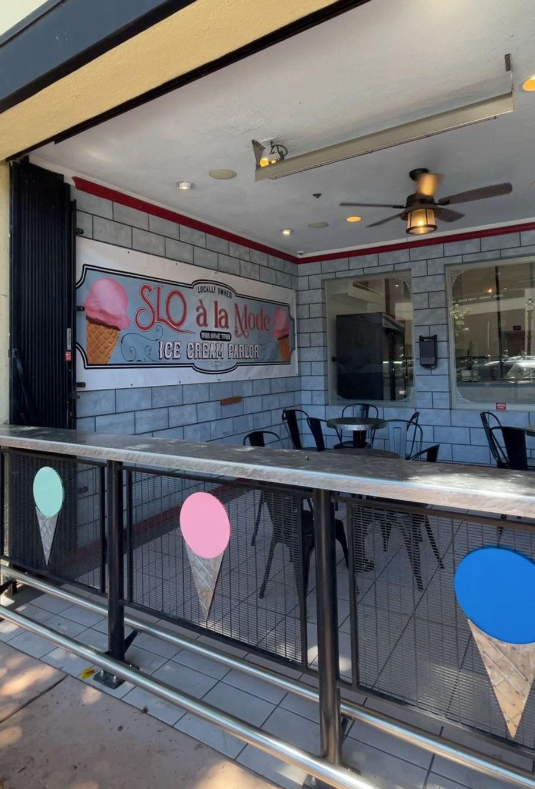
Location and Process
Observed the SLO à la Mode closing process
Reasons:
  Employees flagged this process
  Owner only incurs costs
Focused observation on:
  Task order and duration
  Worker movement through store
Notes:
Mention not being complex as initially thought

Slide 3
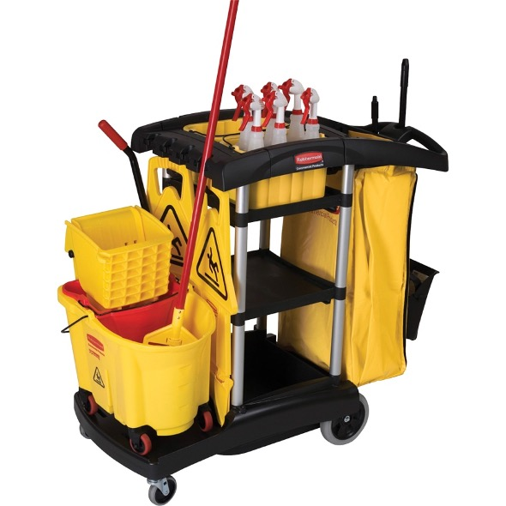
Findings and Improvements
Cleaning Supplies
Trash
Results
  Single worker travels a lot
  Lots of double backing
Improvement Idea
  All in one cleaning cart
  Saves ~3-5 minutes of unnecessary travel
Additional Storage
One Pass Through Store!!
Mop
wheels
Notes:
Double backing tasks: Mopping, taking out trash, wiping counters and tables, and stacking chairs.

Slide 4
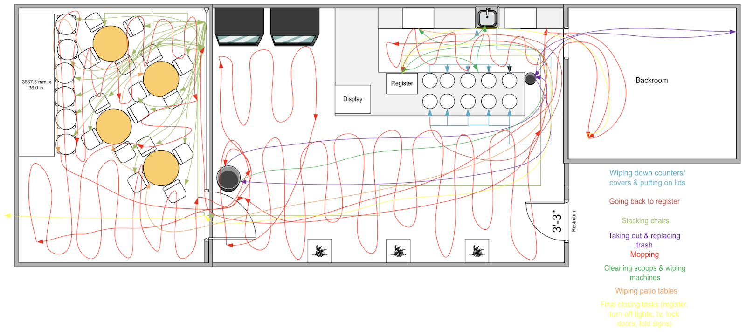
Process Examination, MUDA
DTS
Spaghetti
MUDA
  Motion ex: Trash
  Transport ex: Lids
  Inventory ex: Ice cream

Slide 5
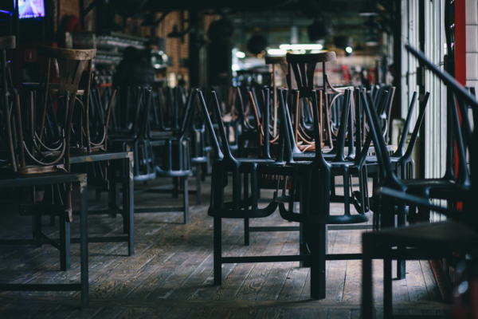
Learning Curve,Improvement
Improvement
Get chairs that will fit over the tables.
Reduces bottleneck
L/C Analysis - high learning rate

Slide 6
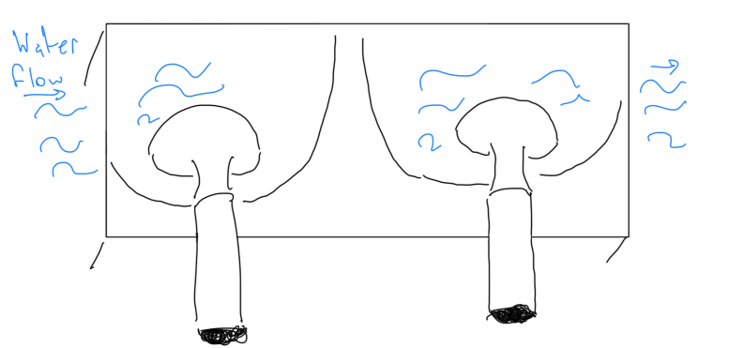
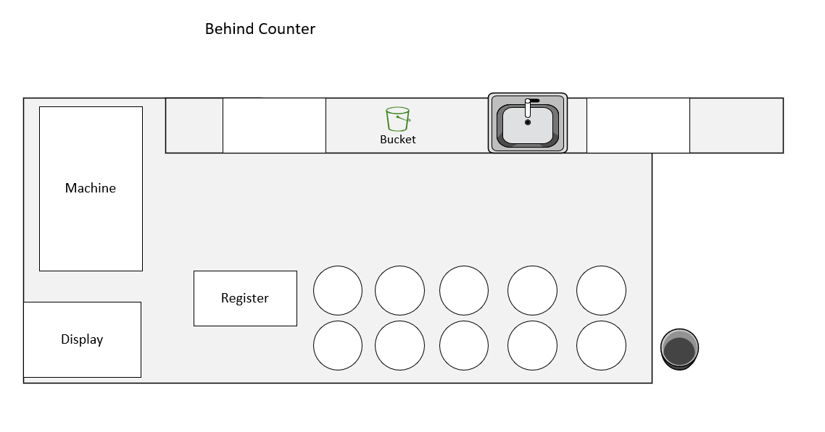

5S Implementation
Figure 1-1: Scoop bin
01
Sort
Mounted scoop bin under ice cream station (Figure 1-1)
02
Set in Order
Designated bucket for used towels (Figure 1-2)
03
Shine
Daily cleaning schedule ensures continuous cleanliness
Figure 1-2: Bucket for towels
04
Standardize
Detailed closing checklist
05
Sustain
Employee training, visual aids, and scorecards
Notes:
Sort: Saves time during high-volume periods
Set: Reduces walking distance, saves time, and maintains a cleaner workspace
Standardize: Enhances consistency and efficiency
Sustain: Encourages a culture of continuous improvement

Slide 7
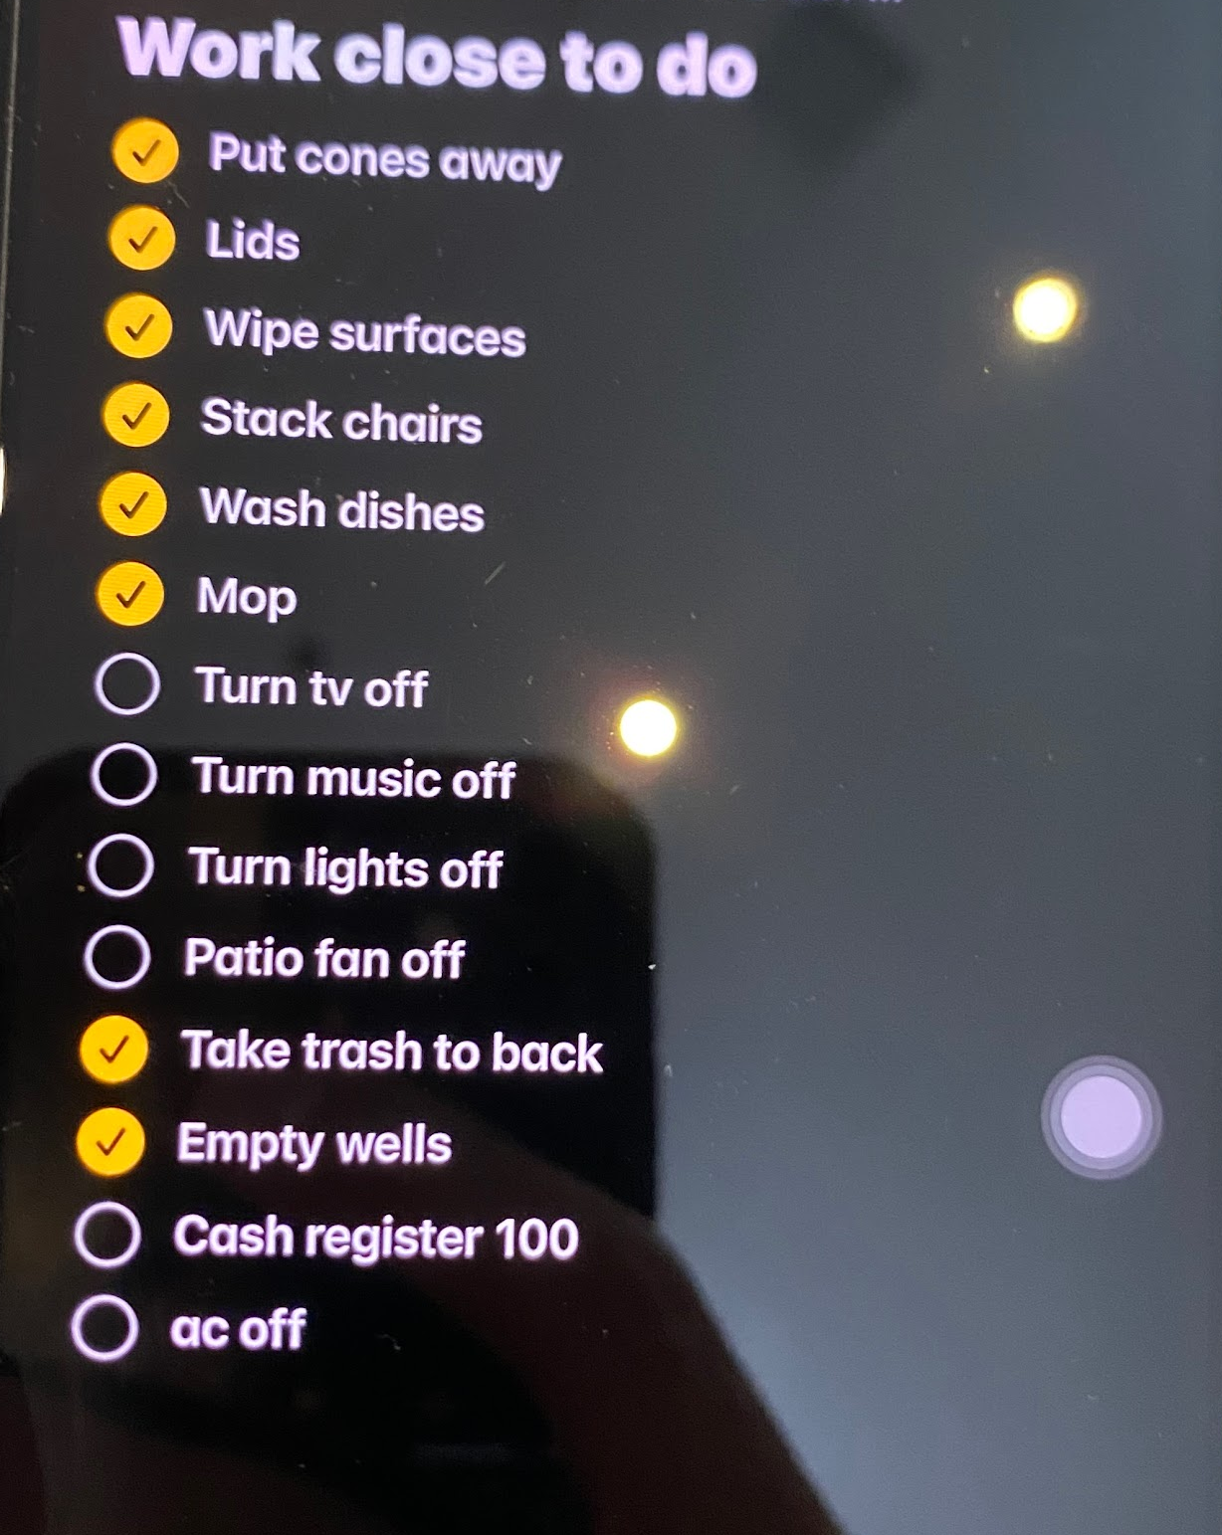
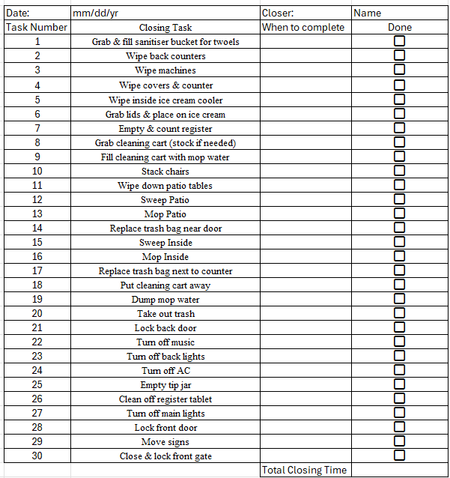
Standardized Checklist for Efficiency & Consistency
What it currently looks like
Improvement Idea
Future Steps
Conduct time and motion studies for optimized closing

Slide 8
Questions?

